Slide 1
City of Rockville Population Projections and Dashboard
Data 205 Final Project
Tigist Wujira
Nancy Condon
Fall 2024
Notes:
Tigist

Slide 2


Introduction
Data 205 Capstone course at Montgomery College, in collaboration with the City of Rockville’s Planning and Community Services Department.
Dashboard that displayed U.S. Decennial Census Data
Population Projection from 2030-2040
Comparison of Population Projection Populations and Estimated Housing
= ?
Notes:
Tigist
Dashboard that displayed U.S. Decennial Census Data
The dashboard was created using data on population, housing, economic, poverty, and social characteristics from the U.S. Census Bureau and the American Community Survey (2020 and 2022).
(Nancy will talk about some of the key facts on the dashboard in a moment

Slide 3
Dashboard
Community Data & Trends | Rockville, MD - Official Website
Notes:
Nancy

Slide 4
Population Projections
Goal
Provide population projections for years 2030 to 2040 by Age and Sex cohorts in 5-year estimates.
Data
U.S. 2010 and 2020 Decennial Census, Age and Sex Cohort tables.
Method
Hamilton-Perry
Linear Interpolation
Tools
EXCEL, Python, Power BI
Notes:
Tigist

Slide 5
Hamilton-Perry Method
The Hamilton-Perry Method is an acceptable method for small population projections. A variant of the Cohort Component Model:
P_{t+n} = population_{t-1} + births – deaths + net migrants
Key components:
It can be used to develop estimates by age, sex, race
Requires only two most recent U.S. Censuses
Uses Cohort Change Ratios / Child Women Ratios
Applies a constant rate of growth for the individual cohort;
Ratios >1 represent growth and <1 represents decline;
It can lead to high projections in rapidly growing places and low projections in areas with population losses.
Notes:
Nancy

Slide 6
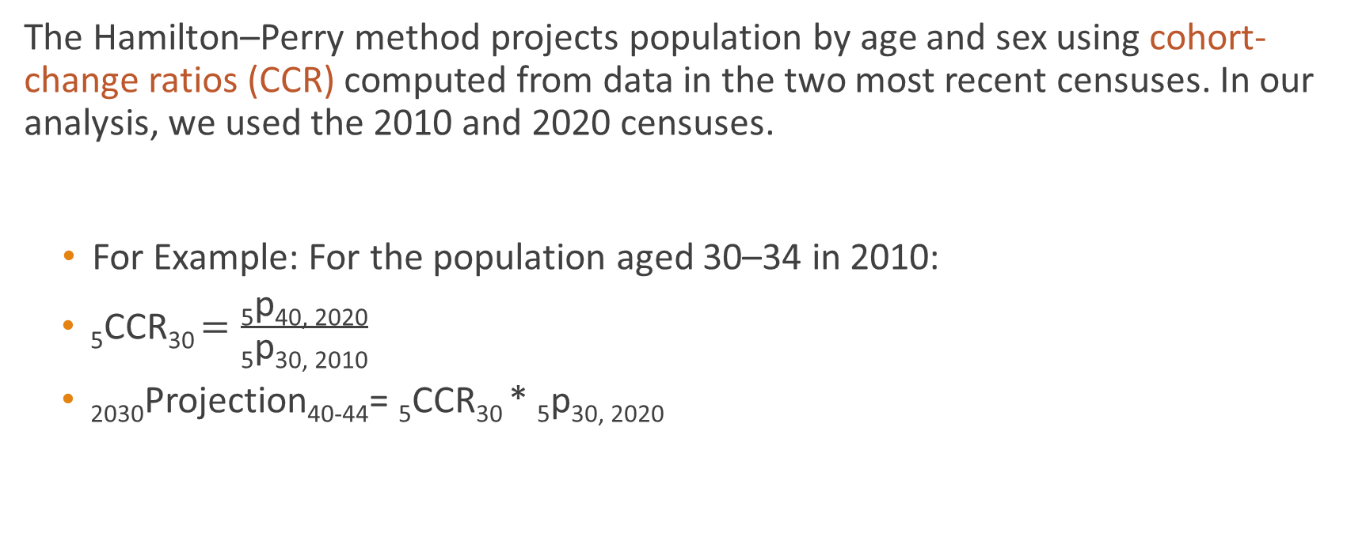
Hamilton-Perry Formulas
The Hamilton–Perry method projects population by age and sex using cohort-change ratios (CCR) computed from data in the two most recent censuses. In our analysis, we used the 2010 and 2020 censuses.
For Example: For the population aged 30–34 in 2010:
₅CCR₃₀ $=\frac{\text{5}\text{p}\text{40, 2020}}{\text{5}\text{p}\text{30, 2010}}$
₂₀₃₀Projection₄₀₋₄₄= ₅CCR₃₀ * ₅p_{30, 2020}
Notes:
Tigist

Slide 7

Child-Woman Ratio
WR was used to project the youngest populations aged 0 to 9.
$CWR\left(0−4\right)= \left.\left( \frac{Population aged 0–4}{women population aged 15−44}\right.\right)$
$CWR(5−9) = \left.\left( \frac{Population aged 5–9}{women population aged 20−49}\right.\right)$

Slide 8
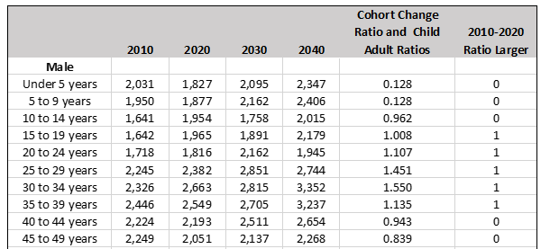
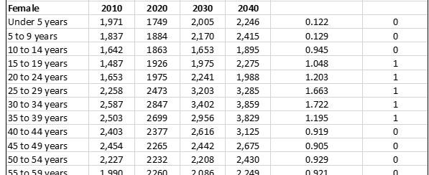

Initial Population Projections
Notes:
The 20-year growth rate (2020-2040) for the total population is estimated to be 20.5% with an annual rate at approximately 1.0%. For both males and females, ages 15 to 35 years had a CCR >1 projecting population growth or net migration.

Slide 9
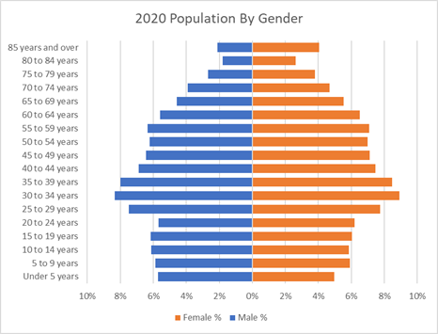
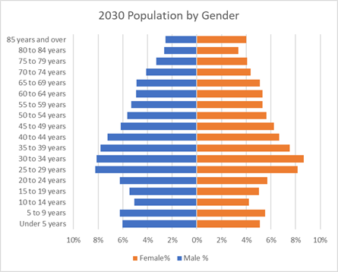
Population By Gender
Notes:
Nancy
In comparison to the year 2020, 2030 the population has changed. For both decades, females make up about 53% of the population. Birth rates appear stable and life expectancy is increasing with women living longer. A decrease 10- to 19-year-old group may indicate migration or morality.

Slide 10
How Accurate?
According to the literature (Baker et al., 2020), the Hamilton-Perry average error rate for county projections ranges from 6% to 16%.
Given the City of Rockville’s population of 67,000, which places it approximately at the 75th percentile of all U.S. counties, it is reasonable to assume this error rate applies.
It is important to recognize that this method may not accurately capture rapid demographic shifts or unusual local trends. However, in the case of Rockville, the growth rate has historically been relatively stable.
Therefore, the results can be considered reliable and suitable for planning and decision-making, particularly for short- to medium-term initiatives.
Notes:
Tigist

Slide 11
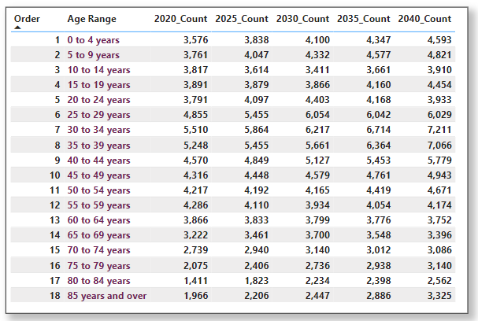
Calculation of 5- Year Estimates
Linear Interpolation
An approach involved using mathematical techniques to generate intermediate data points between known values, enabling us to create a smooth and continuous representation of the population trends.
y = y1+([x-x1)*y2-y1]/(x2-x1)
Linear Interpolation
An approach involved using mathematical techniques to generate intermediate data points between known values, enabling us to create a smooth and continuous representation of the population trends.
y = y1+([x-x1)*y2-y1]/(x2-x1)
Notes:
Tigist

Slide 12
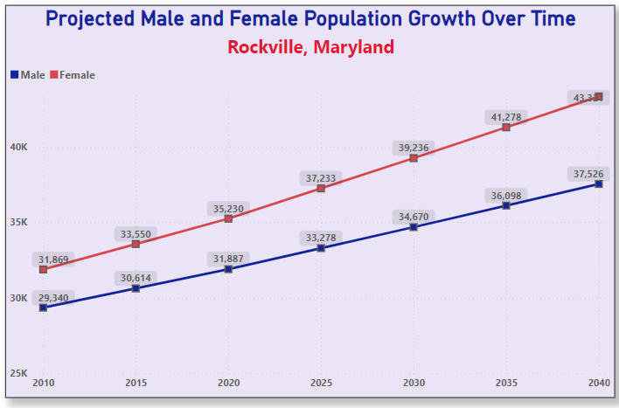
Projected Male and Female population Growth
Despite variations within each cohort, both males and females exhibit a positive linear trend over time.
The female population exceeds the male population by at least 10% at various points in time.
Based on our projections, from 2020 to 2040, the female population is expected to grow by 23%, while the male population will grow by only 17.7.
*Note: The Y-axis on the line chart starts at 25,000.

Slide 13
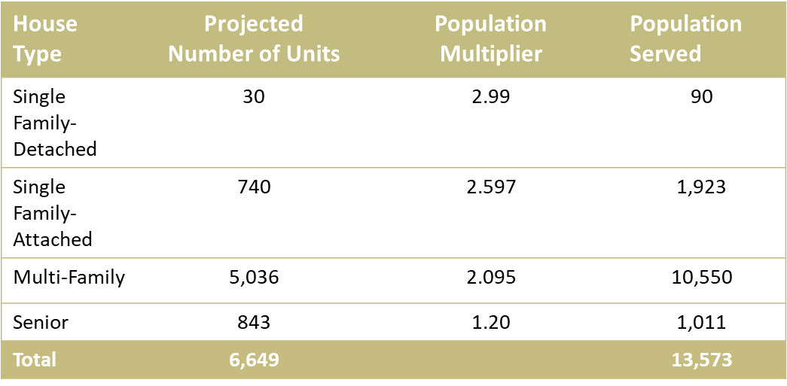
Comparison of Population Projections and Future Housing
Data / Calculation for conversion from ‘units’ to ‘people’
Population Estimates (Hamilton-Perry)
City Residential Projections (Approved Status for 2020-2040)
Population multiplier (2022 Residential Units and Population Estimates Report)
Number of units by ‘type’ of housing * population multiplier = Estimation of Population Served
Notes:
Nancy

Slide 14
Conclusion
Total Population will grow by 13,729 people from 2020 to 2040.
- Projected future housing will approximately serve 13,573 people, a delta of 60 units.
- The are additional housing projects in the pipeline for this time period that were not included these calculations and will exceed the requirement.
The senior population (80+) is projected to grow by 2,510 people from 2020 to 2040.
- Projected housing estimate will serve approximately 1,011 people, a delta of 1250 units.
- Currently there is no additional senior housing projections in the pipeline. It should be noted that not everyone in this age group will desire or need senior housing (home owner, family, multi-family housing).
It is recommended that a more detailed housing needs analysis be conducted for the age group 80 and over population.

Slide 15
Acknowledgements
We would like to give a “BIG THANK YOU” to:
City of Rockville sponsors (Abe Bruckman, Manisha Tewari and Jace Swain-Crowley, Willie Choi) for their internship opportunity, mentorship, and allowing us to participate in a meaningful project.
Professor Jane Valentine, Professor Lori Perine, Professor Rachel Saidi for their encouragement, guidance and their active participation in our project.
Data 205 Classmates for their wonderful feedback and “just being there”.
“It takes a village......”
Notes:
Tigist

Slide 16
References
Vink, Jan K. 2020 Adirondack Park Population by Age and Sex Using the Hamilton-Perry Method. Program on Applied Demographics, Cornell University, 2020.
Swanson, David, Schlottmann, Alan, Schmidt, Richard. “Forecasting the Population of Census Tracts by Age and Sex: An Example of the Hamilton–Perry Method in Action.” Population Research and Policy Review, vol. 28, no. 1, 2009, pp. 47–63.
Baker, Jack, David Swanson, and Jeff Tayman. “The Accuracy of Hamilton–Perry Population Projections for Census Tracts in the United States.” Population Research and Policy Review, vol. 40, no. 2, 2021, pp. 193–219.
Housing Market Analysis and Needs Assessment, City of Rockville, Maryland. Lisa Sturtevant & Associates, LLC, 2016.
2022 Residential Units and Population Estimates, City of Rockville Maryland.
U.S. Census Bureau. "Profile Of General Population and Housing Characteristics." Decennial Census, DEC Demographic Profile, Table DP1, 2020, https://data.census.gov/table/DECENNIALDP2020.DP1?q=Profile of general demographic and housing estimates in Rockville. Accessed on October 9, 2024.
Notes:
Tigist

Slide 17
References
U.S. Census Bureau. "Selected Social Characteristics in the United States." American Community Survey, ACS 5-Year Estimates Data Profiles, Table DP02, 2022, https://data.census.gov/table/ACSDP5Y2022.DP02?q=selected social characteristics in Rockville. Accessed on October 9, 2024.
U.S. Census Bureau. "Poverty Status in the Past 12 Months." American Community Survey, ACS 5-Year Estimates Subject Tables, Table S1701, 2022, https://data.census.gov/table/ACSST5Y2022.S1701?q=poverty status in Rockville city, Maryland. Accessed on October 10, 2024.
U.S. Census Bureau, U.S. Department of Commerce. "Selected Economic Characteristics." American Community Survey, ACS 1-Year Estimates Data Profiles, Table DP03, 2023.https://data.census.gov/table/ACSDP1Y2023.DP03?q=selected economic characteristics in Rockville, Maryland. Accessed on October 27, 2024.

